Slide 1
Object Oriented Programming—C++ Lecture7 Polymorphism
Qijun Zhao
College of Computer Science
Sichuan University
Spring 2025

Slide 2
Table of Contents
1. Polymorphism
2. Inheritance Casting and Run-time Type Identification

Slide 3
Polymorphism

Slide 4
Polymorphism
Polymorphism
In Object-Oriented Programming (OOP), polymorphism (meaning “having multiple forms”) is the capability of an object of mutating its behavior in accordance with the specific usage context
• At run-time, objects of a base class behaves as objects of a derived class
• A Base class may define and implement polymorphic methods, and derived classes can override them, which means they provide their own implementations, invoked at run-time depending on the context

Slide 5
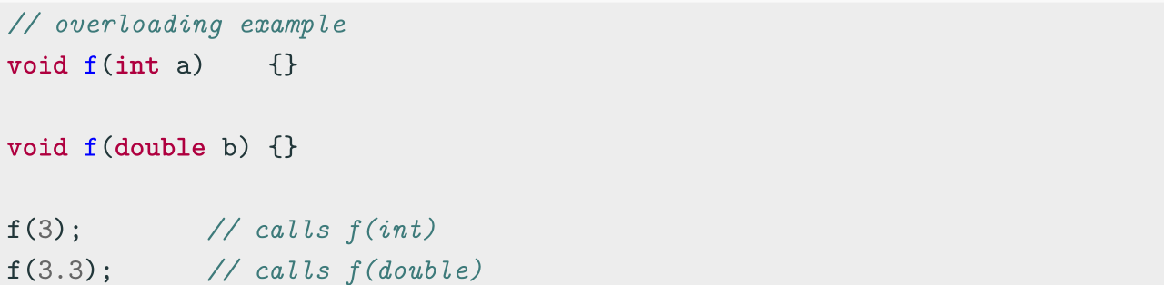
Polymorphism vs. Overloading
Overloading is a form of static polymorphism (compile-time polymorphism)
In C++, the term polymorphic is strongly associated with dynamic polymorphism
(overriding)

Slide 6
Function Binding
Connecting the function call to the function body is called Binding
• In Early Binding or Static Binding or Compile-time Binding, the compiler identifies
the type of object at compile-time
- the program can jump directly to the function address
• In Late Binding or Dynamic Binding or Run-time binding, the run-time identifies
the type of object at execution-time and then matches the function call with the
correct function definition
- the program has to read the address held in the pointer and then jump to that
address (less efficient since it involves an extra level of indirection)
C++ achieves late binding by declaring a virtual function

Slide 7
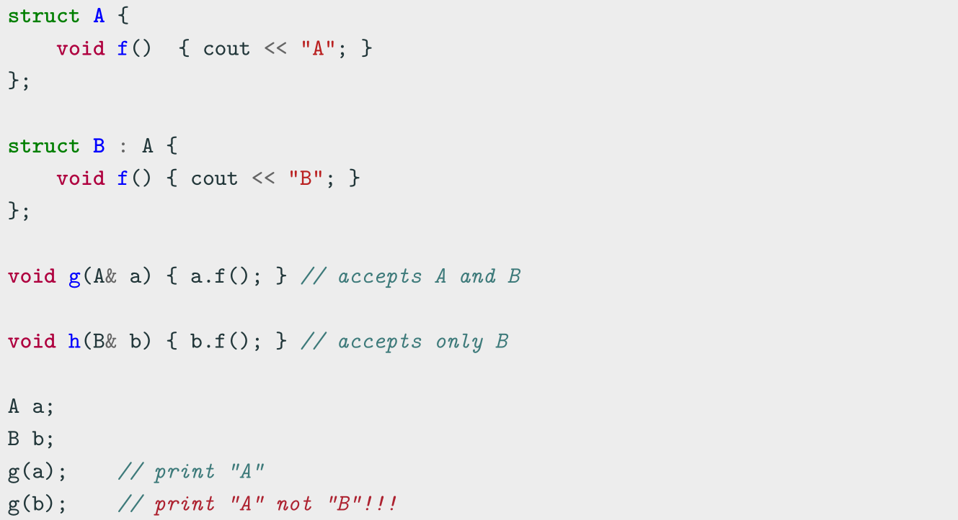
Polymorphism - The problem

Slide 8
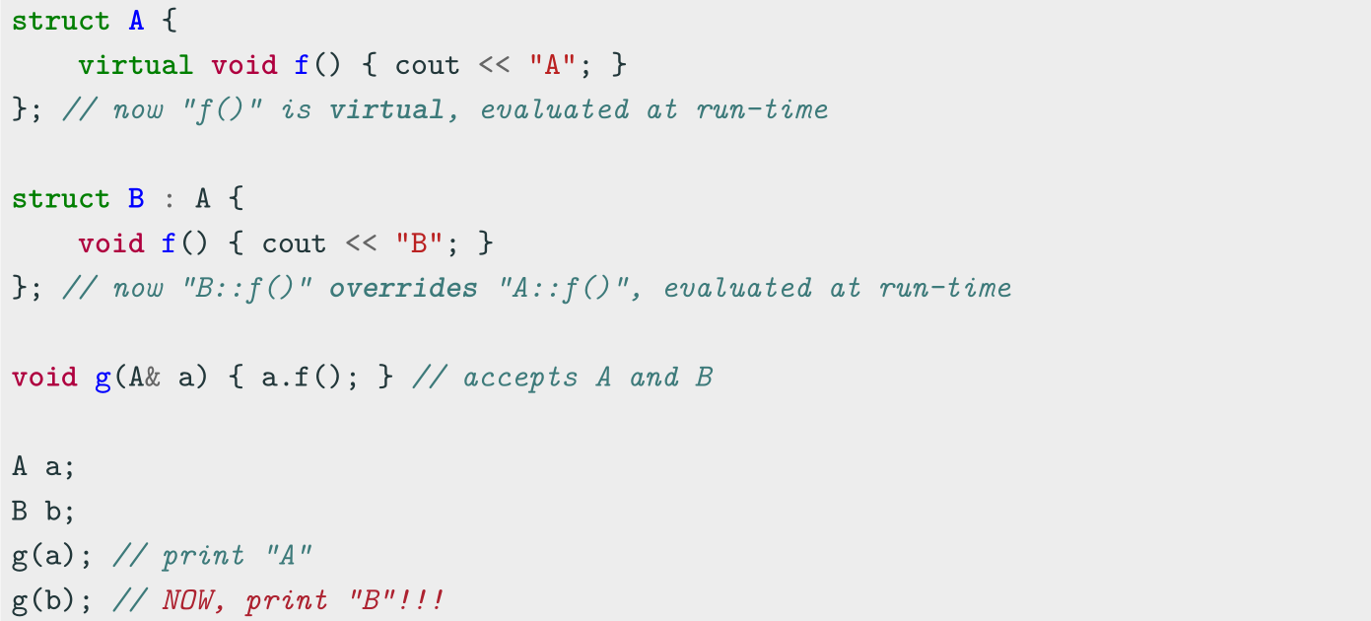
Polymorphism - virtual method
The virtual keyword is not necessary in derived classes, but it improves readability and
clearly advertises the fact to the user that the function is virtual

Slide 9
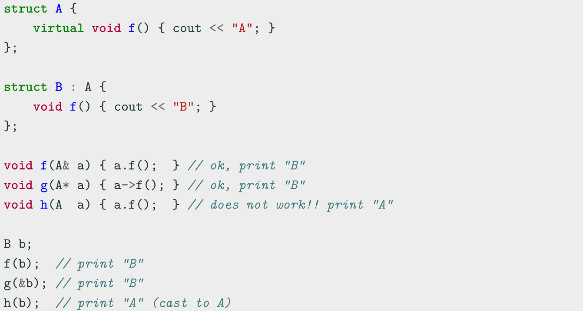
When virtual works

Slide 10
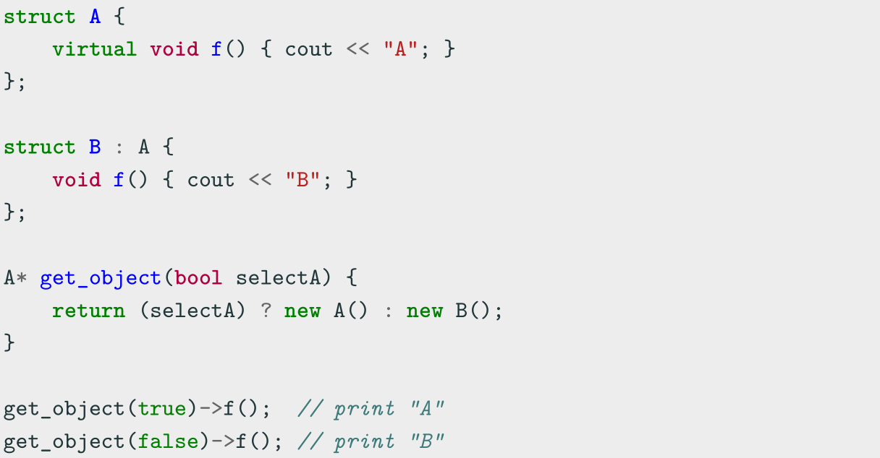
Polymorphism Dynamic Behavior

Slide 11
Virtual Table
vtable
The virtual table (vtable) is a lookup table of functions used to resolve function calls and support dynamic dispatch (late binding)
A virtual table contains one entry for each virtual function that can be called by
objects of the class. Each entry in this table is simply a function pointer that points to
the most-derived function accessible by that class
The compiler adds a hidden pointer to the base class which points to the virtual table
for that class (sizeof considers the vtable pointer)

Slide 12
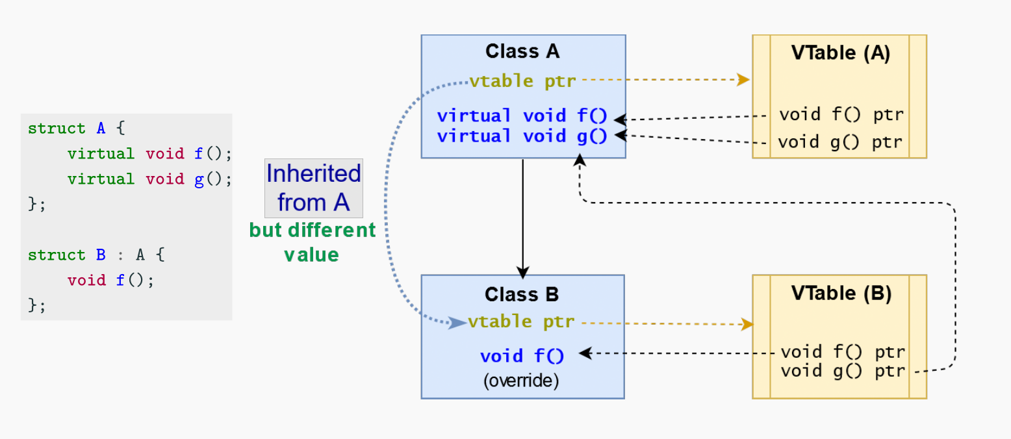
Virtual Table

Slide 13
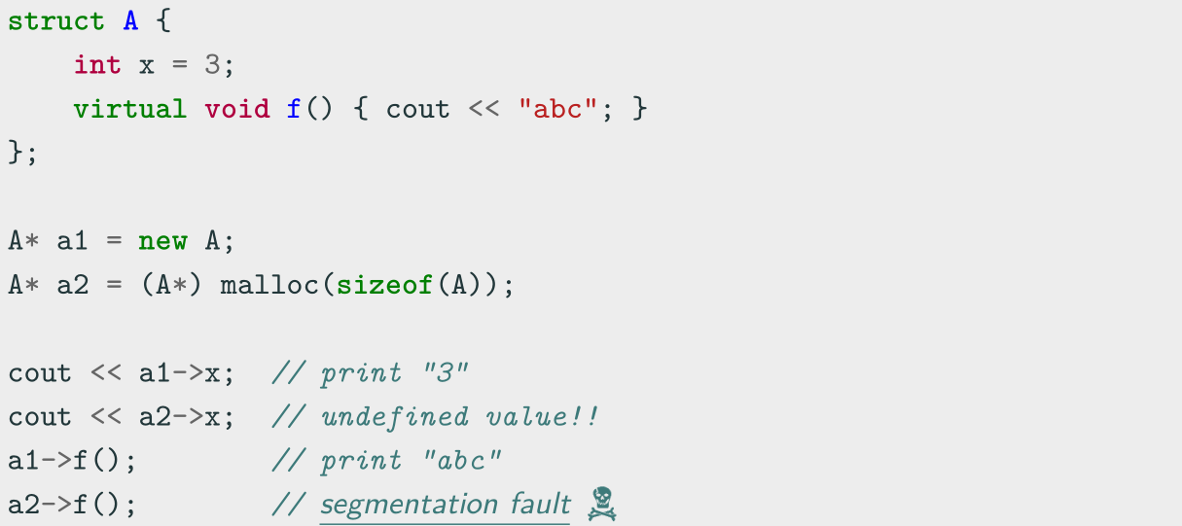
Does the vtable really exist? (answer: YES)
Lesson learned: Never use malloc in C++

Slide 14
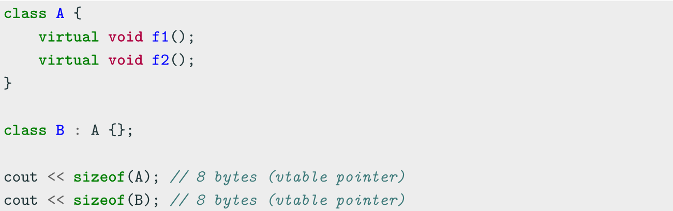
Virtual Method Notes
virtual classes allocate one extra pointer (hidden)

Slide 15
override Keyword
override Keyword ( C++11 )
The override keyword ensures that the function is virtual and is overriding a virtual function from a base class
It forces the compiler to check the base class to see if there is a virtual function
with this exact signature
override implies virtual ( virtual should be omitted)

Slide 16
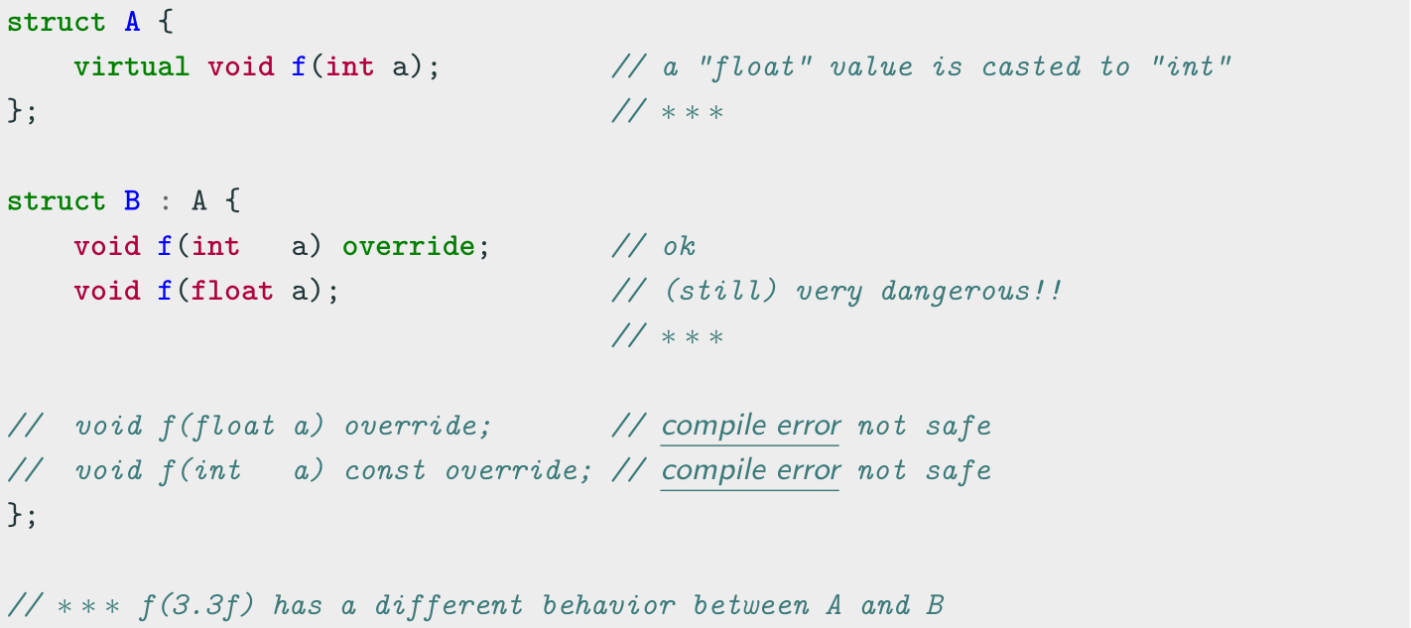
override Keyword

Slide 17
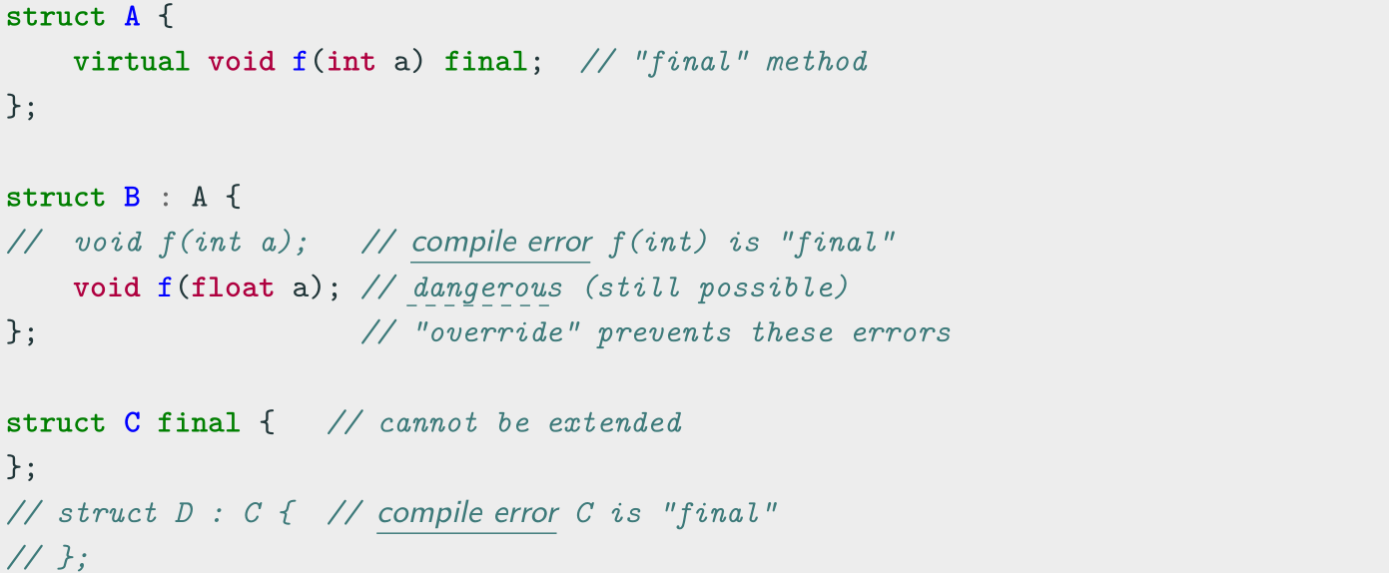
final Keyword
final Keyword ( C++11 )
The final keyword prevents inheriting from classes or overriding methods in derived classes

Slide 18
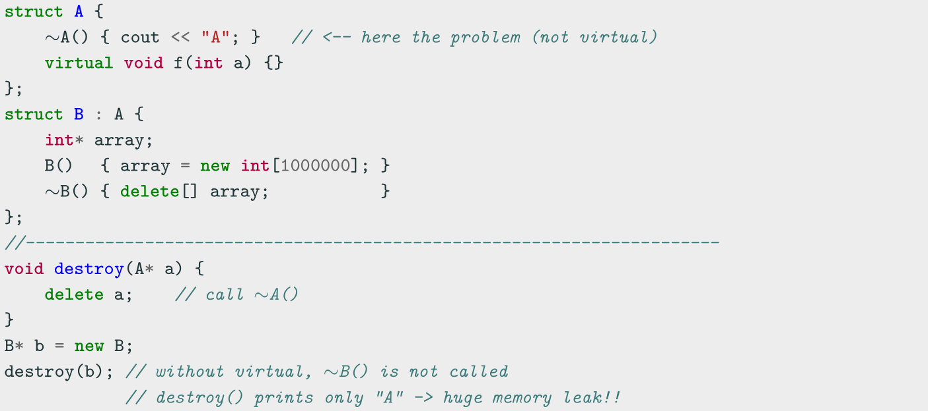
Virtual Methods (Common Error 1)
All classes with at least one virtual method should declare a virtual destructor

Slide 19
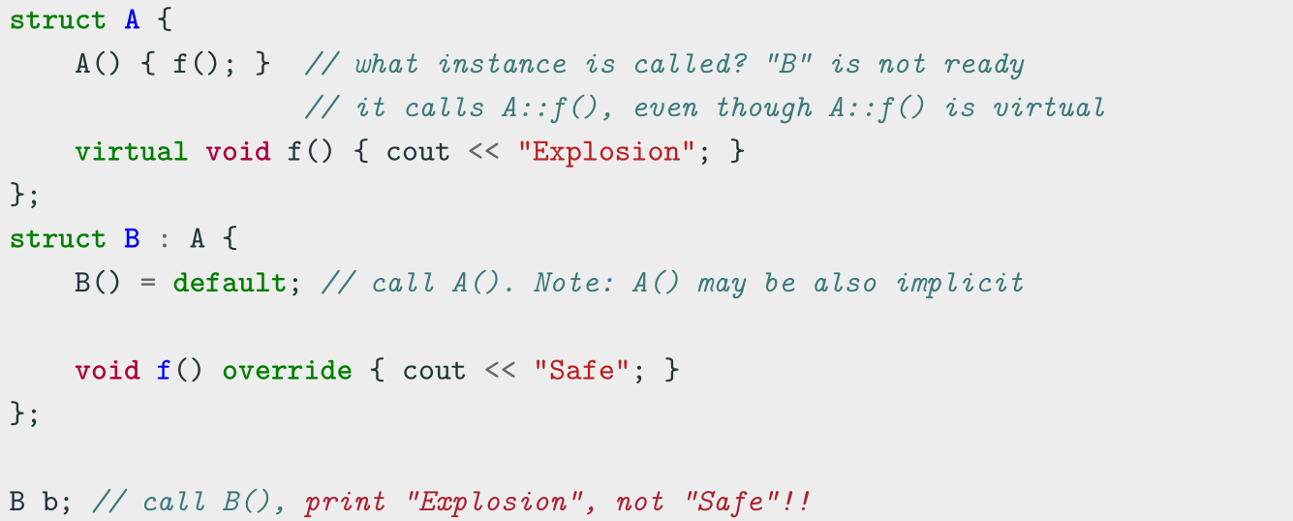
Virtual Methods (Common Error 2)
Do not call virtual methods in constructor and destructor
• Constructor: The derived class is not ready until constructor is completed
• Destructor: The derived class is already destroyed

Slide 20
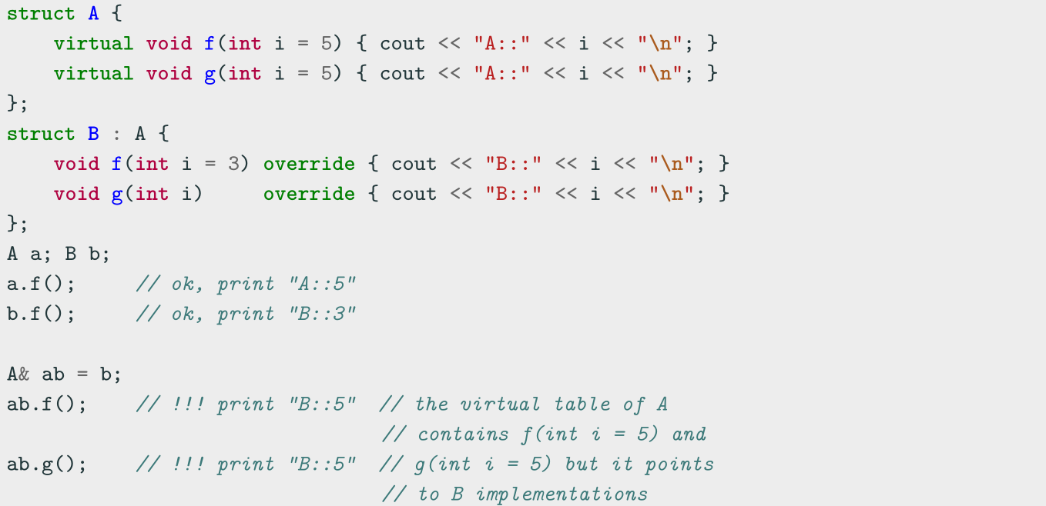
Virtual Methods (Common Error 3)
Do not use default parameters in virtual methods
Default parameters are not inherited

Slide 21
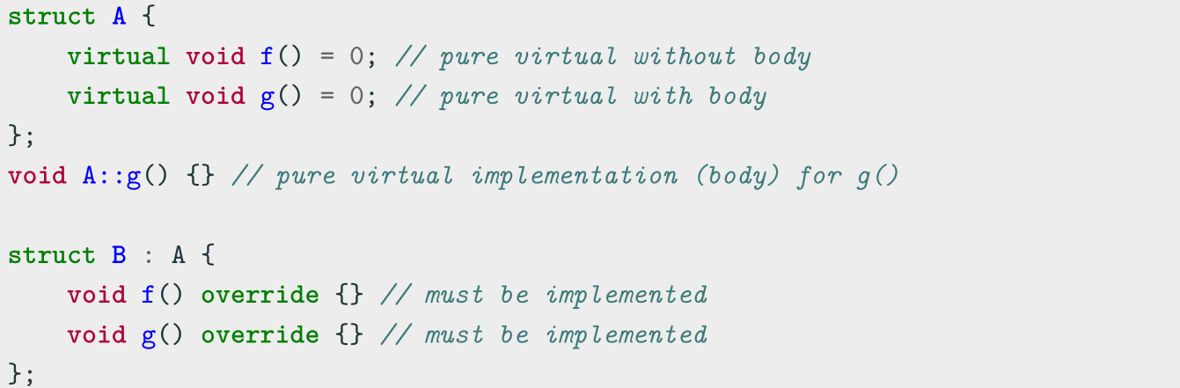
Pure Virtual Method
Pure Virtual Method
A pure virtual method is a function that must be implemented in derived classes (concrete implementation)
Pure virtual functions can have or not have a body

Slide 22
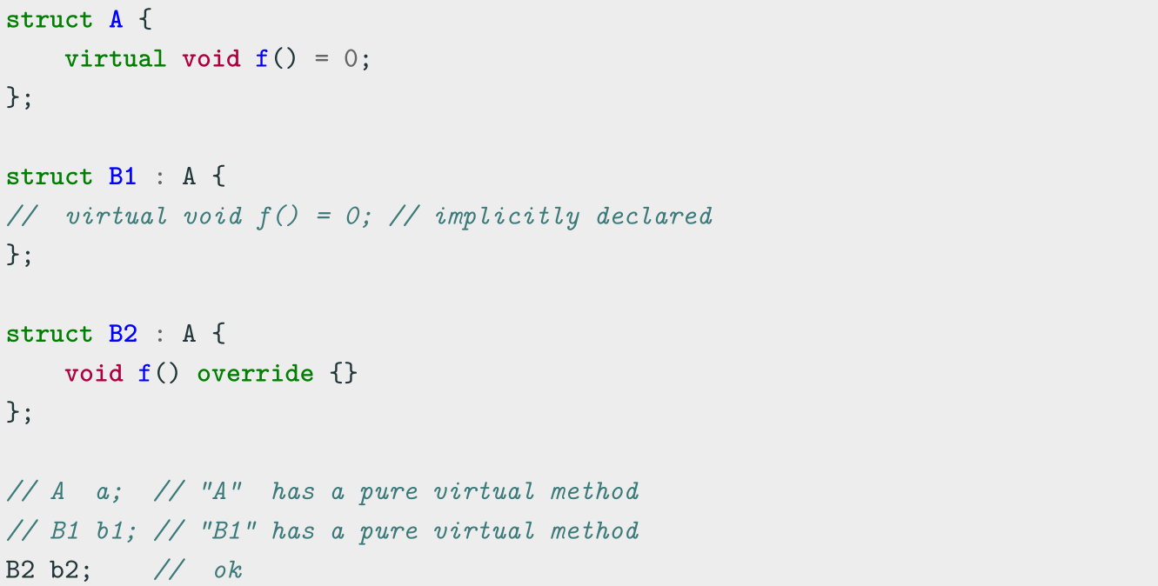
Pure Virtual Method
A class with one pure virtual function cannot be instantiated

Slide 23
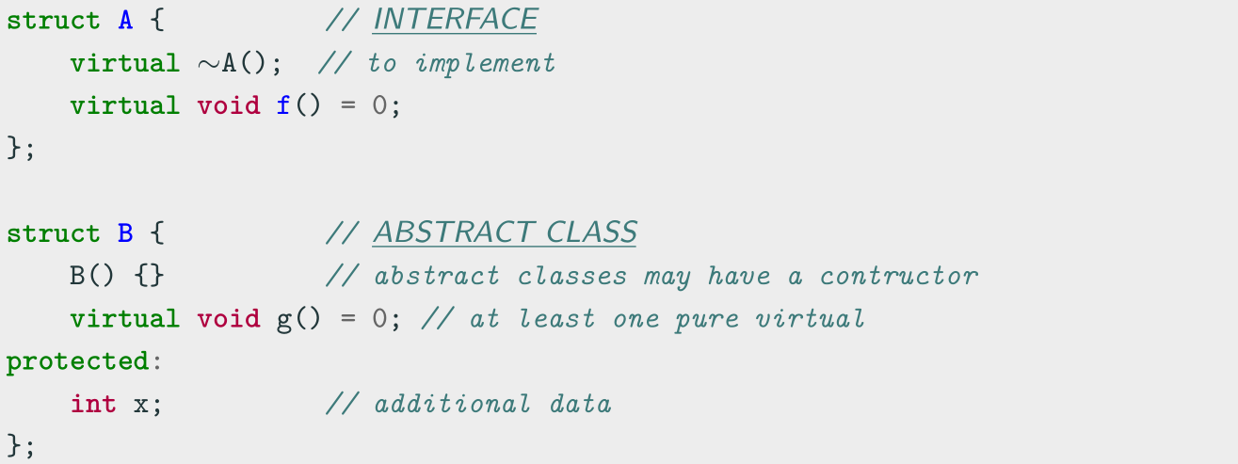
Abstract Class and Interface
• A class is interface if it has only pure virtual functions and optionally (suggested)
a virtual destructor. Interfaces do not have implementation or data
• A class is abstract if it has at least one pure virtual function

Slide 24
Inheritance Casting and Run-time Type Identification

Slide 25
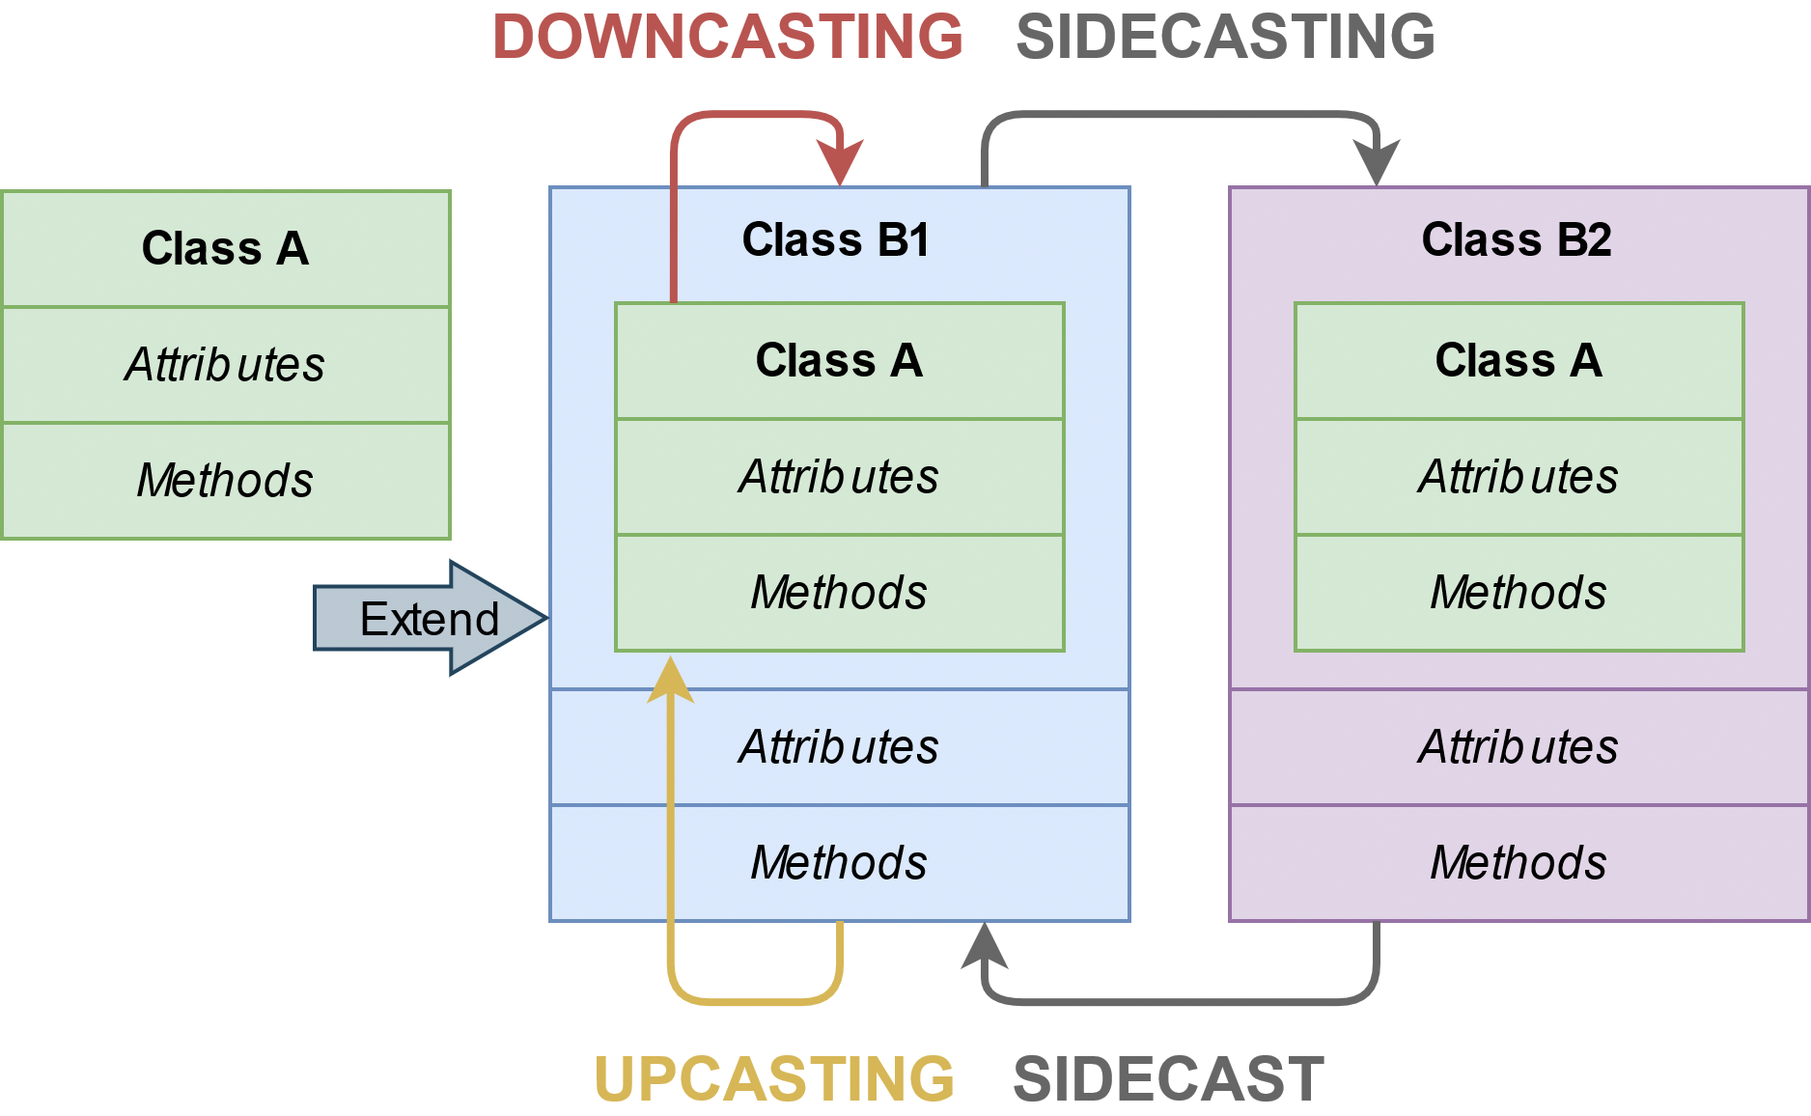
Hierarchy Casting
Class-casting allows implicit or explicit conversion of a class into another one across its hierarchy

Slide 26
Hierarchy Casting
Upcasting Conversion between a derived class reference or pointer to a base class
- It can be implicit or explicit
- It is safe
- static_cast or dynamic_cast // see next slides
Downcasting Conversion between a base class reference or pointer to a derived class
- It is only explicit
- It can be dangerous
- static_cast or dynamic_cast
Sidecasting (Cross-cast) Conversion between a class reference or pointer to an other
class of the same hierarchy level
- It is only explicit
- It can be dangerous
- dynamic_cast

Slide 27
Upcasting and Downcasting Example
struct A {
virtual void f() { cout << "A"; }
};
struct B : A {
int var = 3;
void f() override { cout << "B"; }
};
A a;
B b;
A& a1 = b; // implicit cast upcasting
static_cast<A&>(b).f(); static_cast<B&>(a).f(); cout << b.var;
cout << static_cast<B&>(a).var;
// print "B" upcasting
// print "A" downcasting
// print 3 (no cast)
// potential segfault!!! downcasting

Slide 28
Sidecasting Example
struct A {
virtual void f() { cout << "A"; }
};
struct B1 : A {
void f() override { cout << "B1"; }
};
struct B2 : A {
void f() override { cout << "B2"; }
};
B1 b1; B2 b2;
dynamic_cast<B2&>(b1).f(); dynamic_cast<B1&>(b2).f();
// print "B2", sidecasting
// print "B1", sidecasting
// static_cast<B1&>(b2).f(); // compile error

Slide 29
Run-time Type Identification
RTTI
Run-Time Type Identification (RTTI) is a mechanism that allows the type of an
object to be determined at runtime
C++ expresses RTTI through three features:
dynamic cast keyword: conversion of polymorphic types
typeid keyword: identifying the exact type of an object
type info class: type information returned by the operator
typeid
RTTI is available only for classes that are polymorphic, which means they have at least one virtual method

Slide 30
type info and typeid
type info
class has the method
name()
which returns the name of the type
struct A {
virtual void f() {}
};
struct B : A {}; A a;
B b;
A& a1 = b; // implicit upcasting
cout << typeid(a).name(); // print "1A" cout << typeid(b).name(); // print "1B" cout << typeid(a1).name(); // print "1B"

Slide 31
dynamic_cast
dynamic cast , differently from static cast , uses RTTI for deducing the correctness of the output type
This operation happens at run-time and it is expensive
dynamic cast<New>(Obj)
has the following properties:
Convert between a derived class to a base class
→ upcasting.
New ,
Obj
New
Obj
are both pointers or references
Throw
std::bad cast
if New , Obj is a reference ( T& ) and New , Obj
cannot be converted
Returns if New ,
are pointers ( T* ) and New , Obj cannot be
NULL
Obj
converted

Slide 32
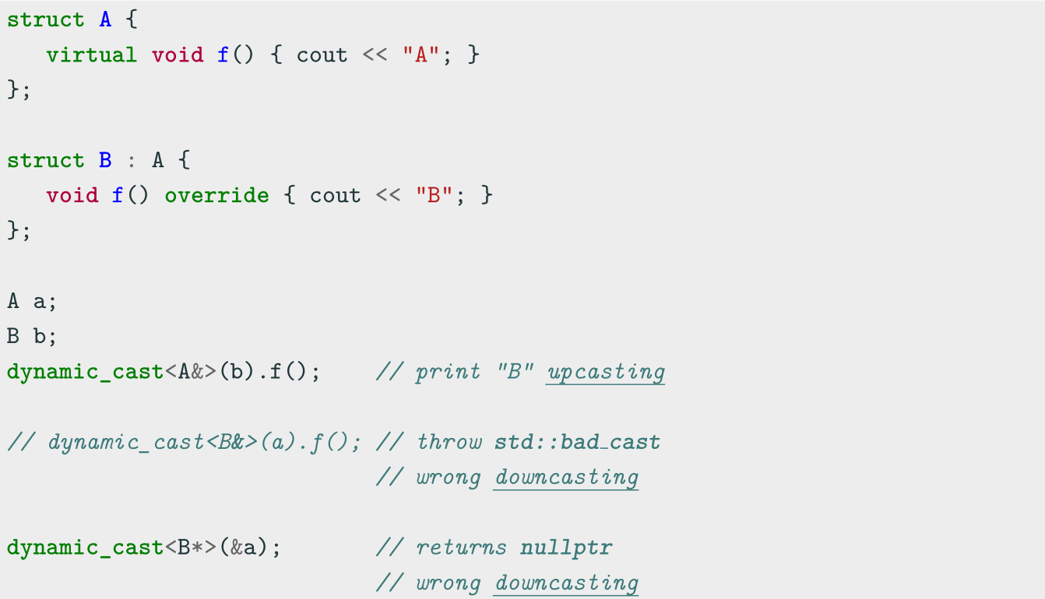
dynamic cast Example 1

Slide 33
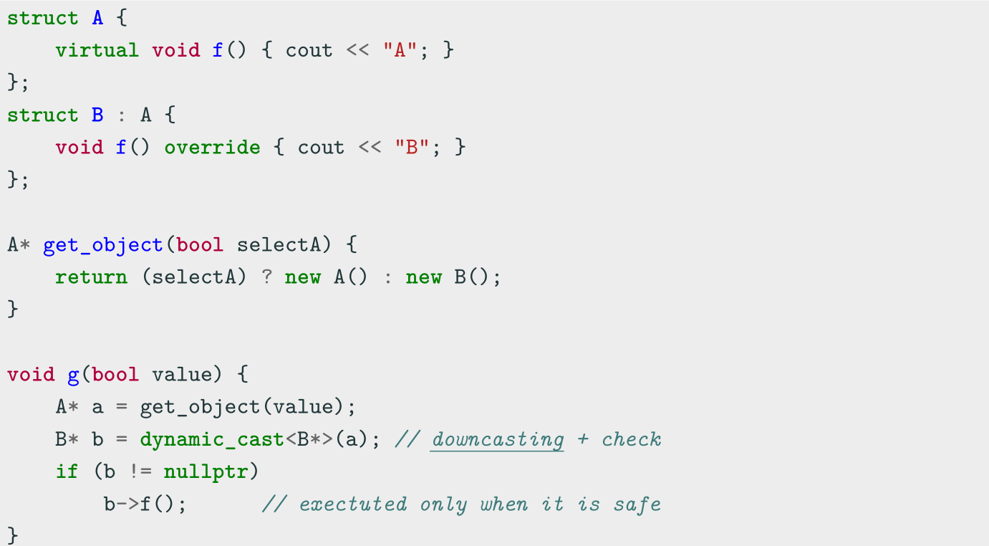
dynamic cast Example 2

Slide 34
Coding to make the world better
Qijun Zhao
qjzhao@scu.edu.cn

